Slide 1

PROFESSIONAL CERTIFICATE IN MACHINE LEARNING AND ARTIFICIAL INTELLIGENCE
Week 6
PCA & Clusters

Slide 2
Agenda
Intro to Supervised and Unsupervised Learning
SVD & PCA
K means
PCA + Clustering

Slide 3

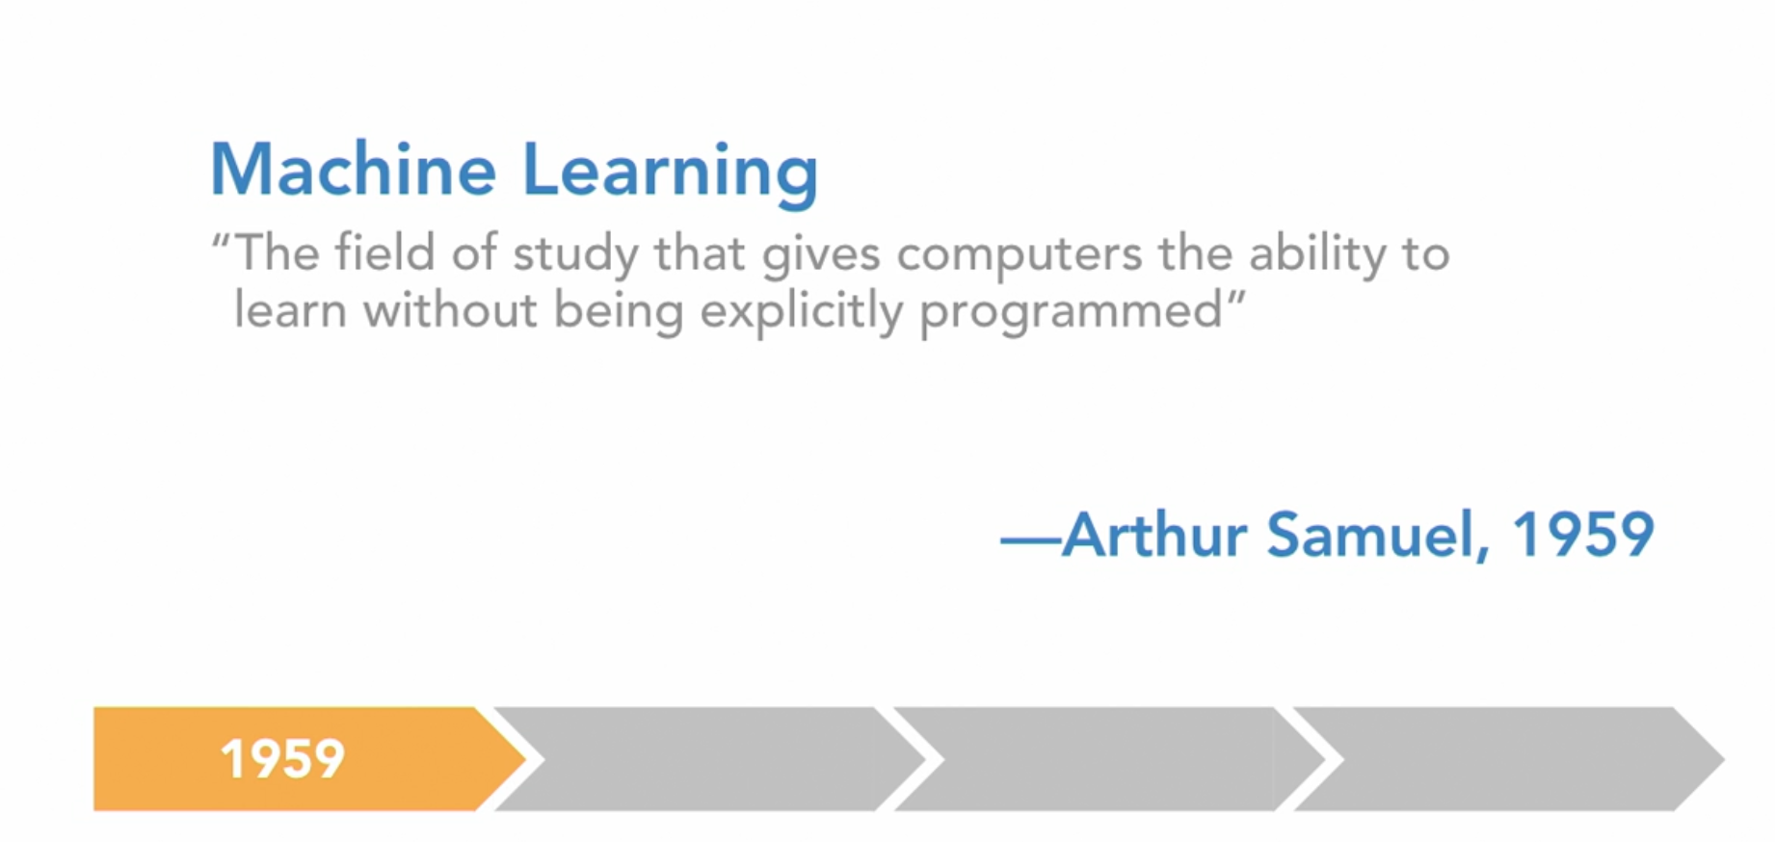
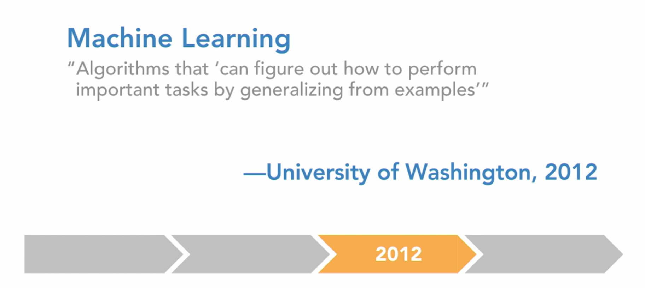
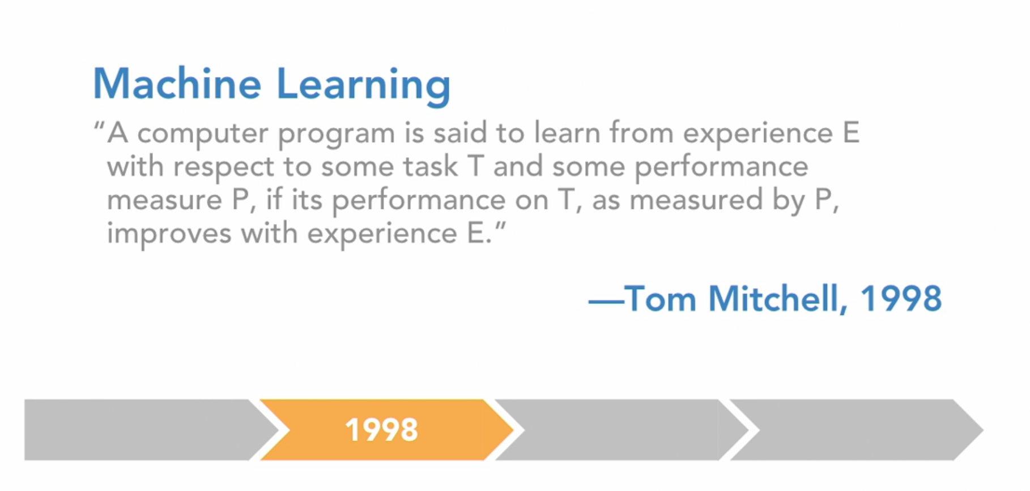
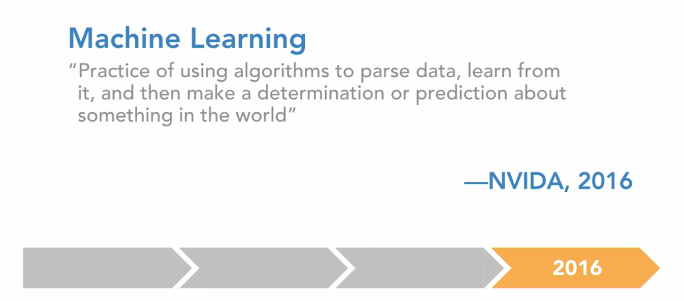
¿Qué es Machine Learning?

Slide 4
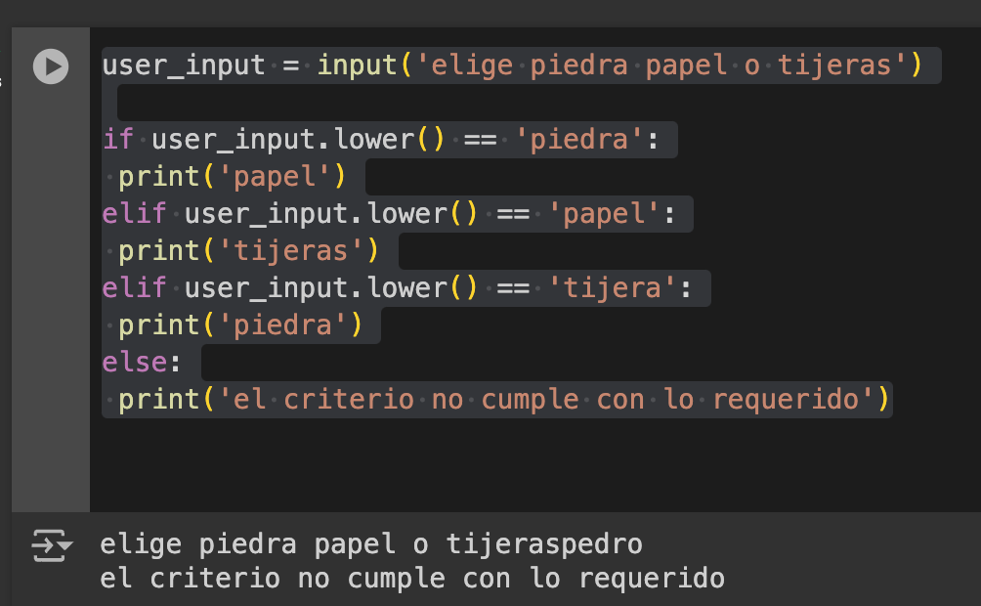
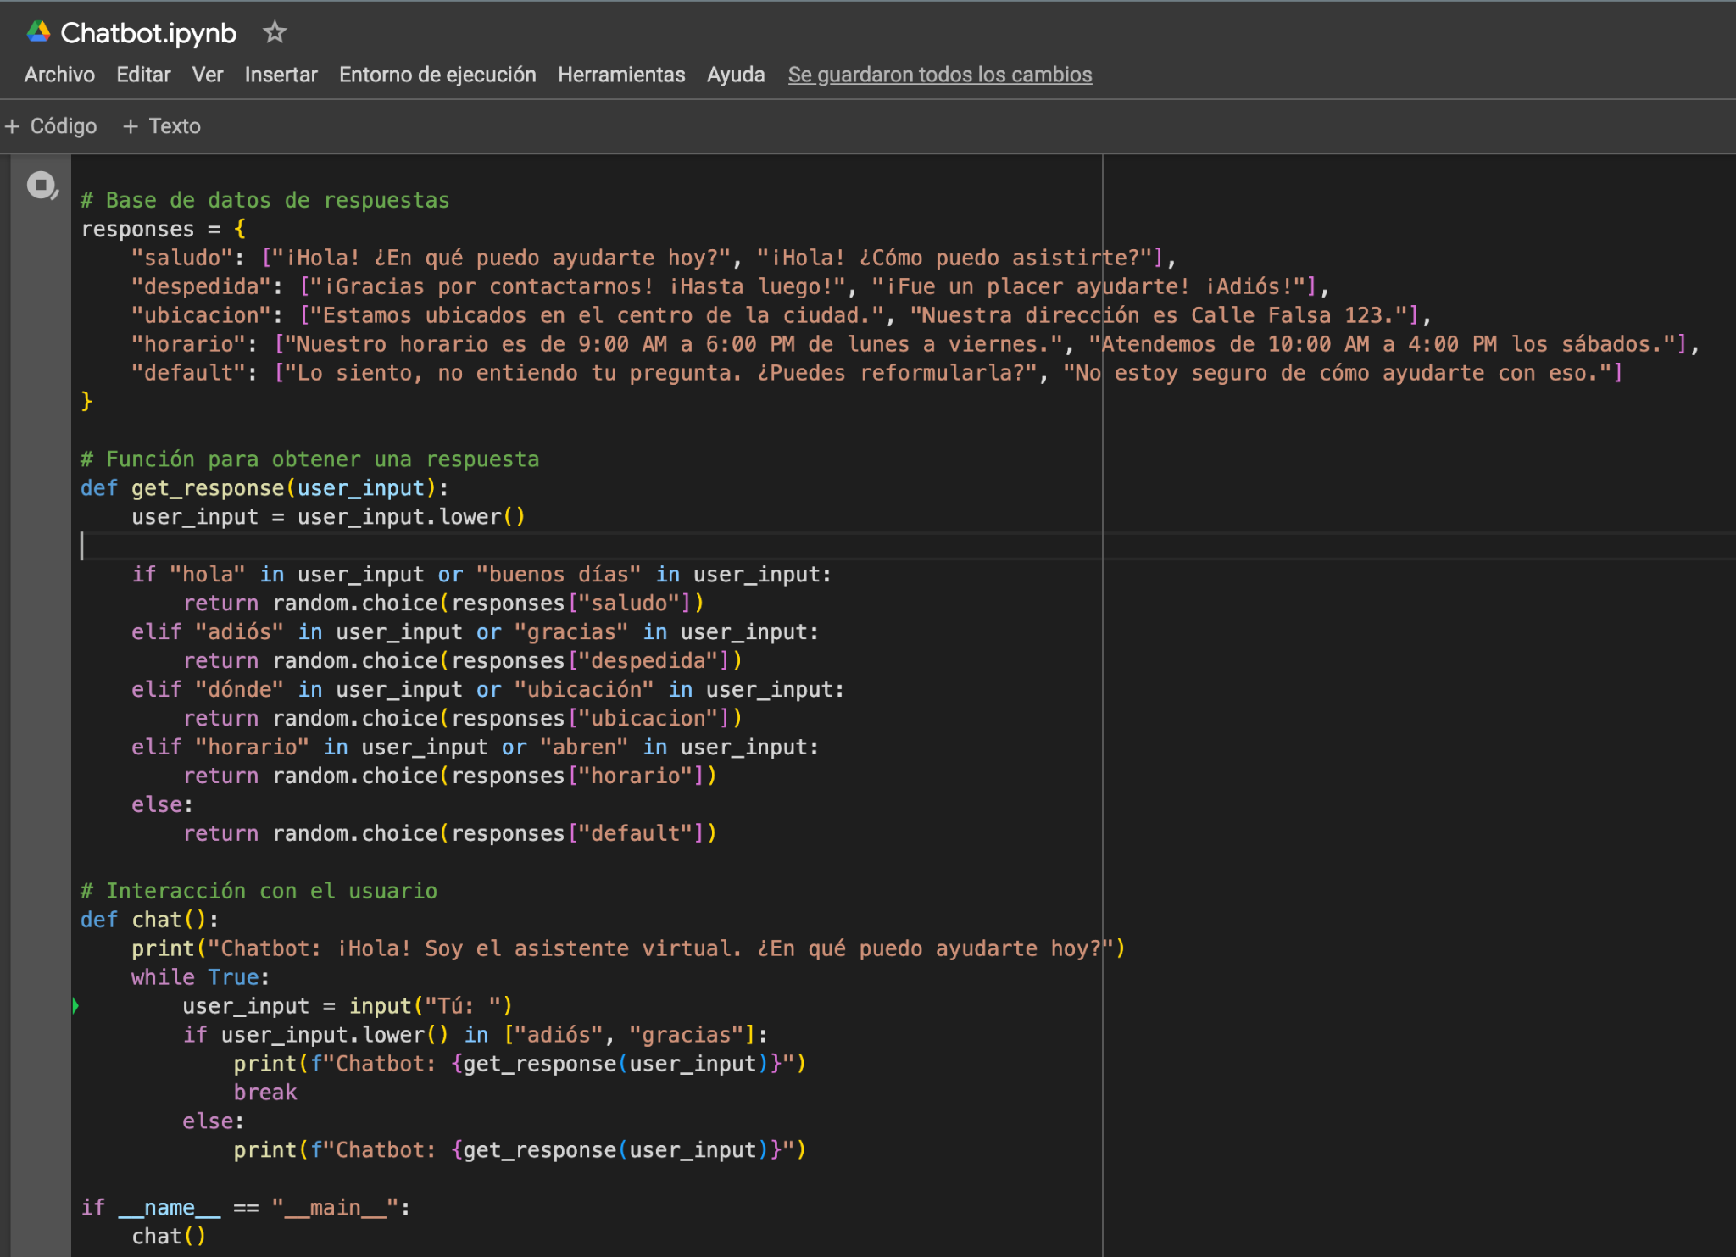
¿Qué no es Machine Learning?

Slide 5

ML Lifecycle
Obtain Data:
Acquire the dataset from various sources such as databases, APIs, files, repositories, web scraping , Open Data ,or any other 3rd party data in general like data Brokers that offer alternative data for data enrichment
Ensure data integrity and verify that the dataset is suitable for the intended machine learning task.
Explore Data:
Perform exploratory data analysis (EDA) to understand the structure, patterns, and characteristics of the dataset.
Summarize statistics, visualize data distributions, and identify potential issues such as missing values, outliers, or class imbalances.
Explore relationships between variables using correlation analysis or other statistical techniques.
Preprocess and Clean Data:
Handle missing values using techniques like imputation or deletion.
Encode categorical variables using methods such as one-hot encoding or label encoding.
Scale numerical features to ensure they have similar ranges and variances, using techniques like StandardScaler or MinMaxScaler.
Handle outliers and anomalies appropriately, considering removal, transformation, or capping techniques.
Address class imbalances using sampling techniques such as oversampling or undersampling.
Identify and select the most relevant features from the dataset that contribute significantly to the predictive power of the model. (Feature Selection)
Reduce dimensionality and computational complexity by removing irrelevant or redundant features. (PCA)
Model Data:
Select an appropriate machine learning algorithm or ensemble of algorithms based on the problem type (classification, regression, clustering) and the dataset characteristics.
Split the dataset into training, validation, and test sets using techniques like cross-validation or holdout validation. ( Data Partition )
Train the model using the training dataset and monitor its performance on the validation set to prevent overfitting.
Tune hyperparameters using techniques like grid search or randomized search to optimize model performance
Bootstrapping is a resampling technique where multiple samples are drawn with replacement from the original dataset.
Evaluate Model:
Assess the performance of the trained model using evaluation metrics appropriate for the specific problem domain (e.g., accuracy, precision, recall, F1-score, ROC-AUC).
Use techniques like cross-validation to obtain robust estimates of model performance and detect overfitting.
Visualize model performance using metrics such as learning curves, ROC curves, or confusion matrices to gain insights into its behavior.
Interpret model predictions and analyze errors to identify areas for improvement.
Iterate and Improve:
Analyze the model's performance and iteratively refine it by tuning hyperparameters, trying different algorithms, or incorporating additional features.
Experiment with feature selection techniques to identify the most informative features and reduce dimensionality.
Regularize the model to prevent overfitting and improve generalization performance.
Incorporate domain knowledge and insights gained from the evaluation phase to enhance model interpretability and effectiveness.
Deploy Model:
Once the model achieves satisfactory performance, deploy it into production where it can make predictions on new, unseen data.
Integrate the model into an application or system where it can be accessed by end-users or other systems.
Monitor the model's performance in production and implement mechanisms for model maintenance, retraining, and updating as needed.

Slide 6
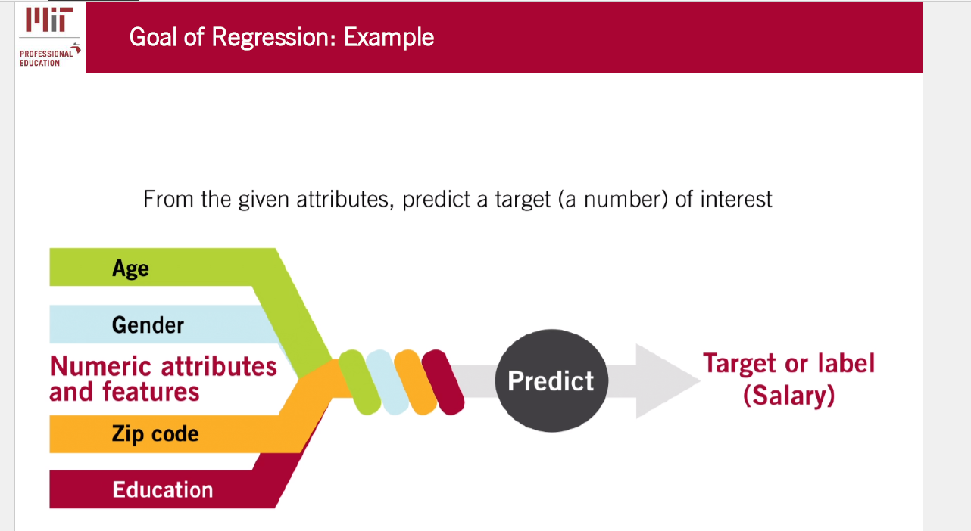
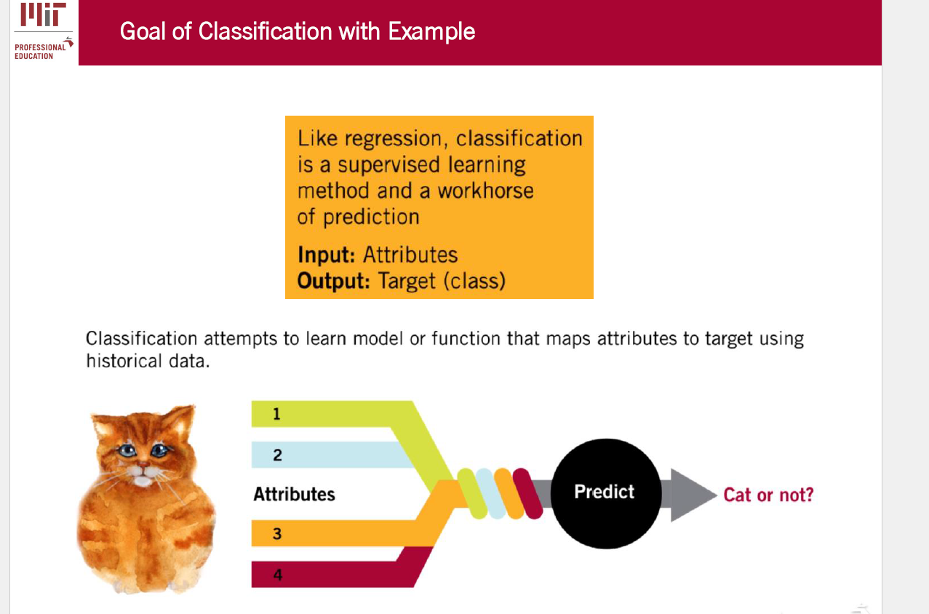

Regresión - Clasificación
Like
Like regression, classification is a supervised learning method and a workhorse of prediction.
Input: Attributes
Output: Target (class)

Slide 7
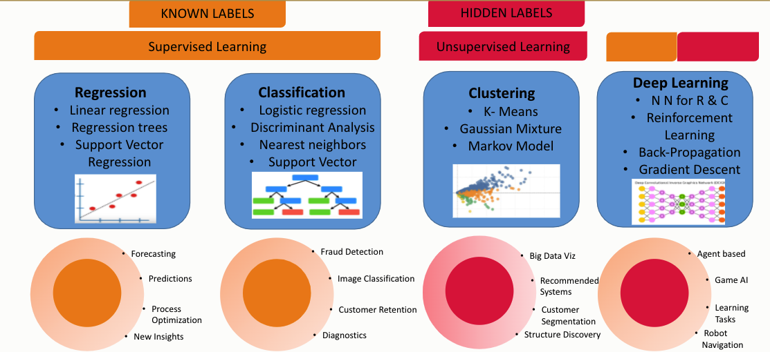
Modelos supervisados y no supervisados

Slide 8
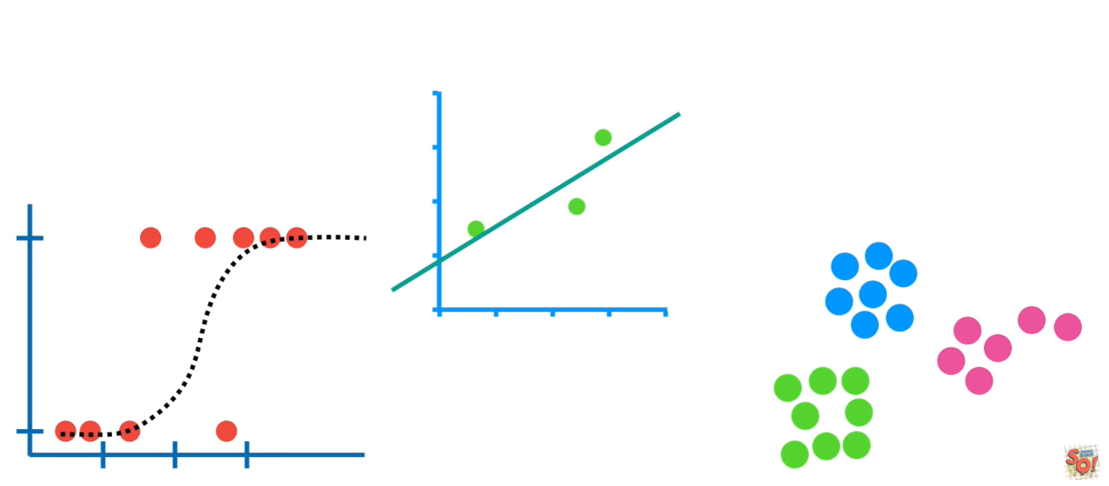
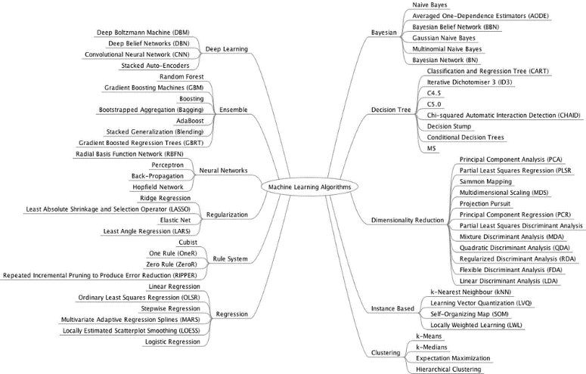
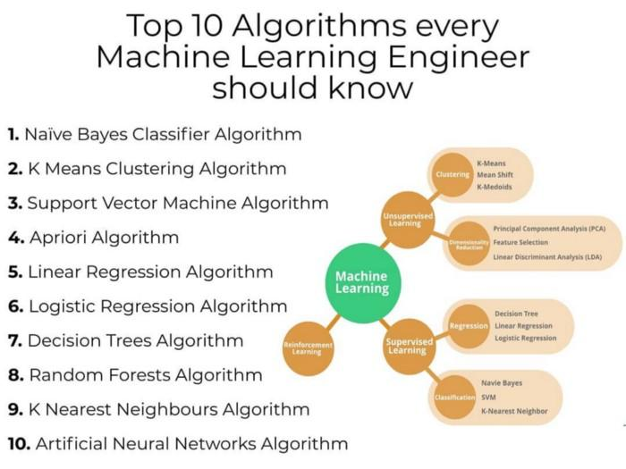
Algoritmos populares

Slide 9
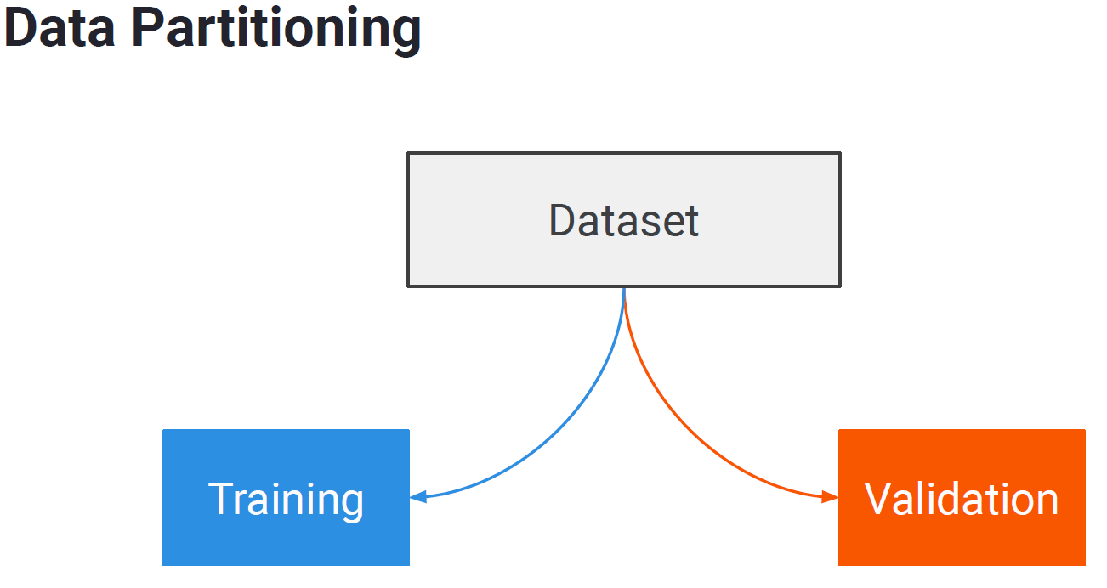
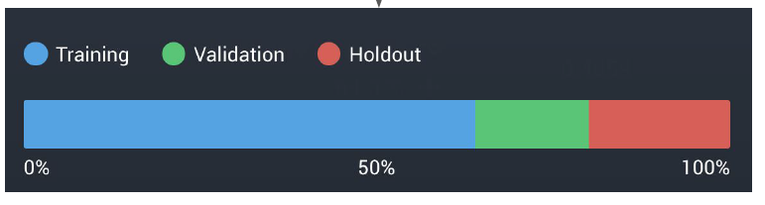
Data partitioning
70%
30%

Slide 10
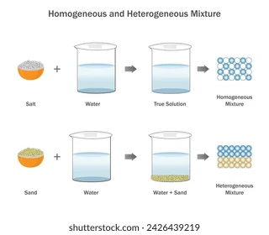
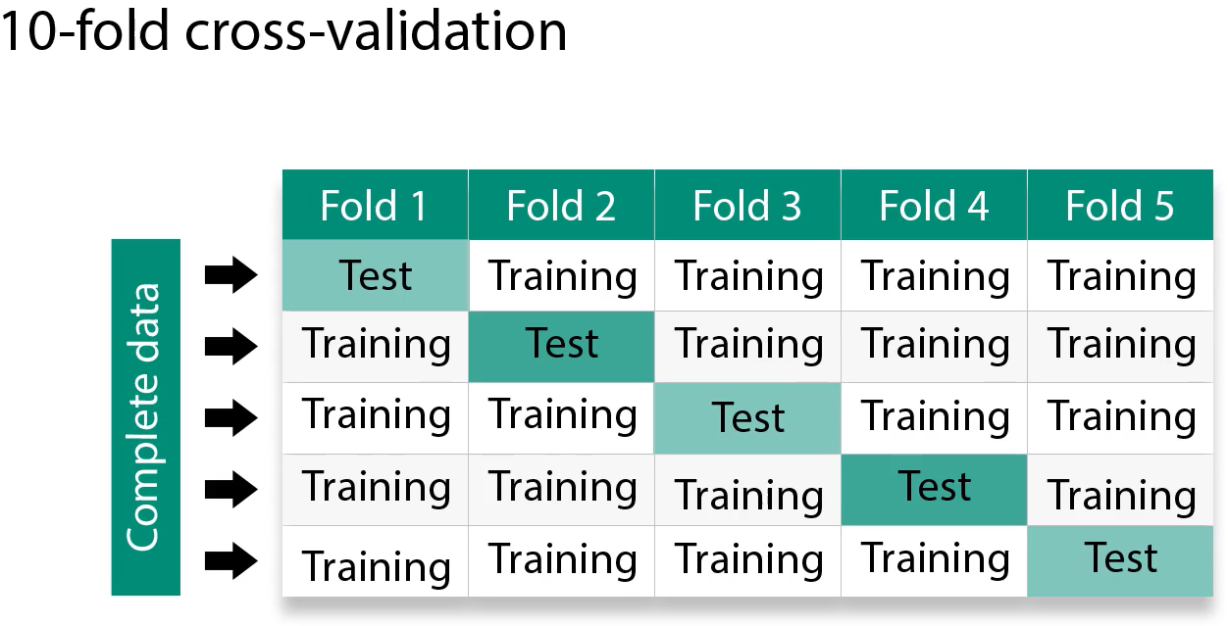
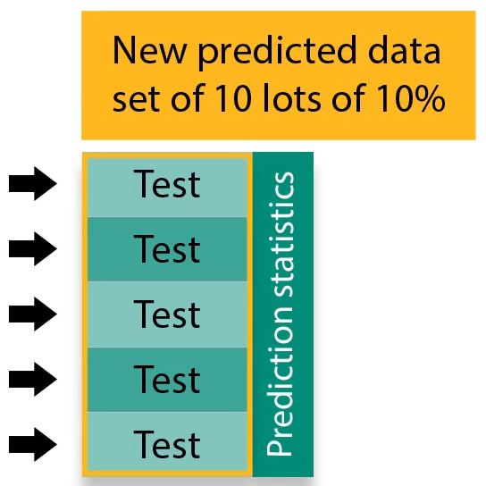
Homogeneidad y representatividad estadística
Test

Slide 11
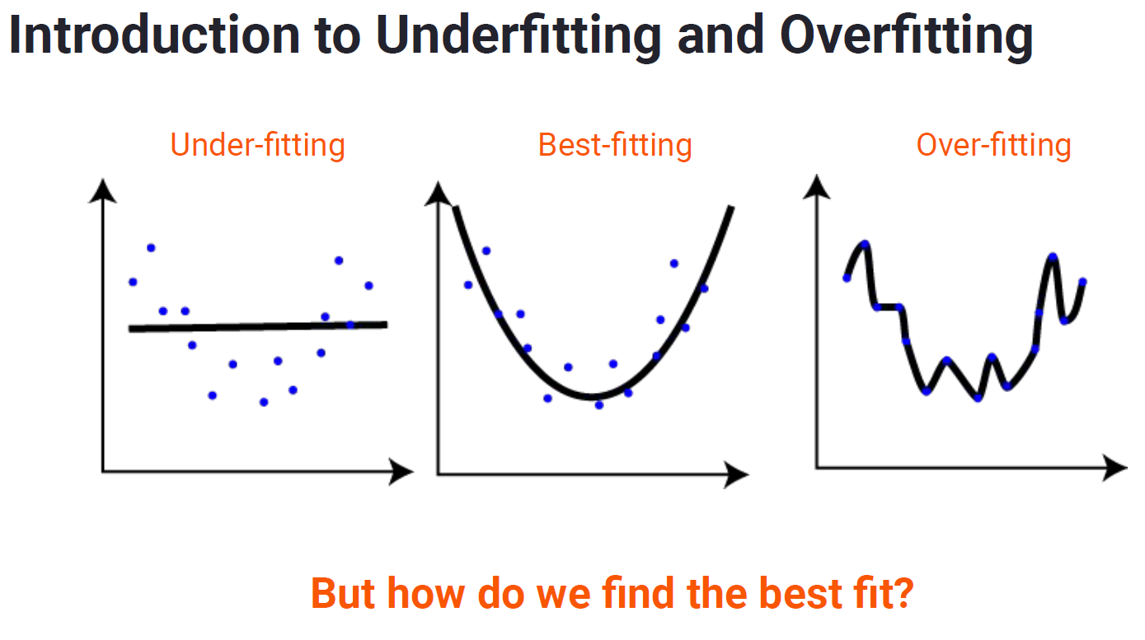
Validación del Modelo
Test

Slide 12
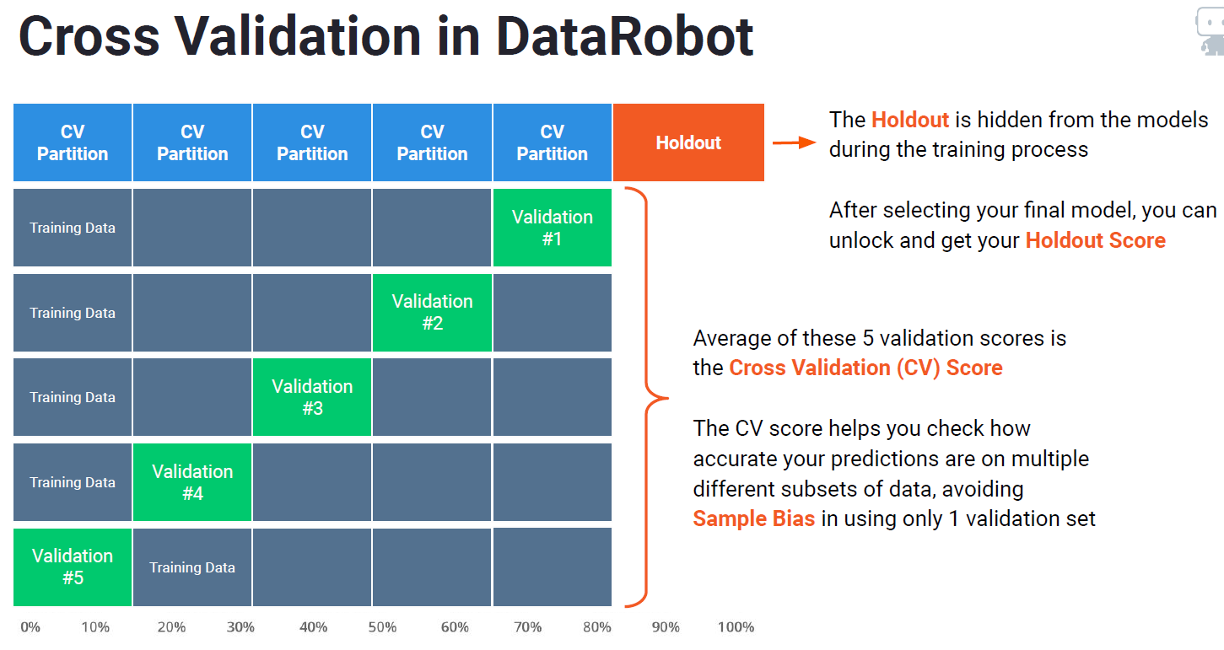
Hold Out
Test

Slide 13
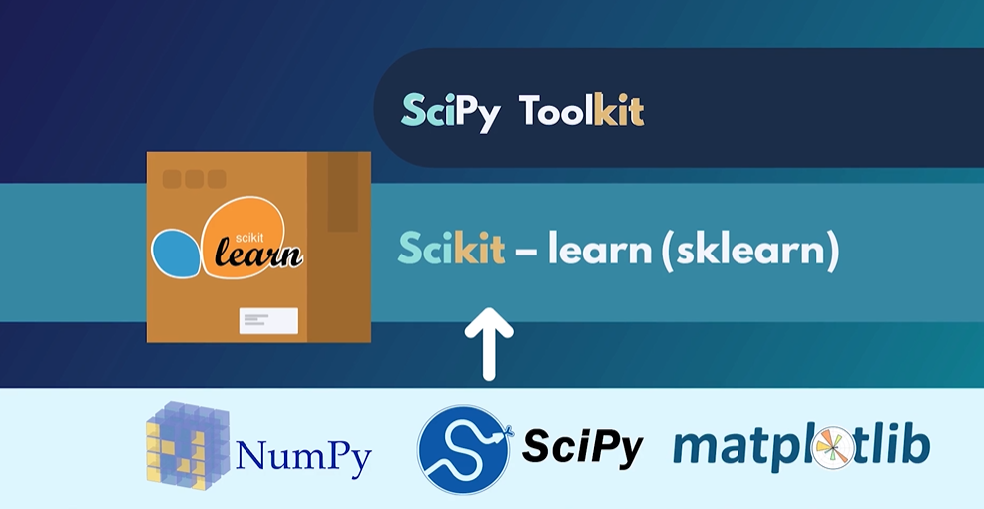
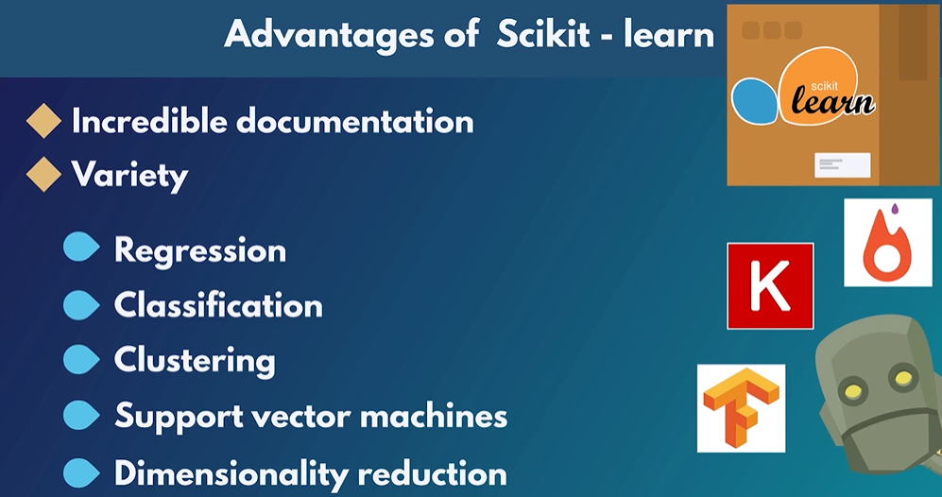
Ejemplo de bibliotecas para Machine Learning
Test
https://scikit-learn.org/stable/

Slide 14
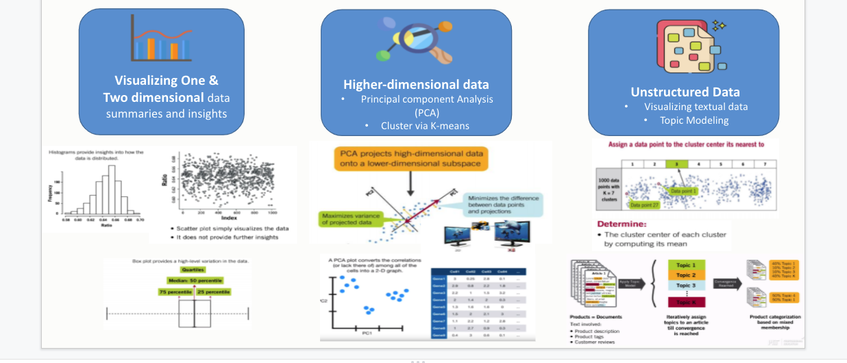
Multidimensional Visualization

Slide 15
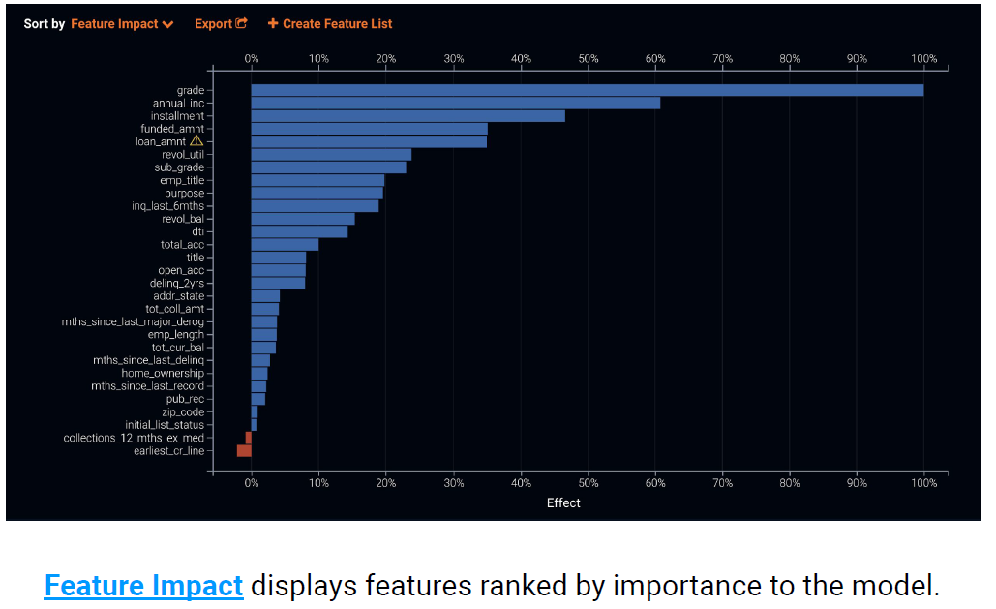
Feature Selection auto Machine Learning

Slide 16
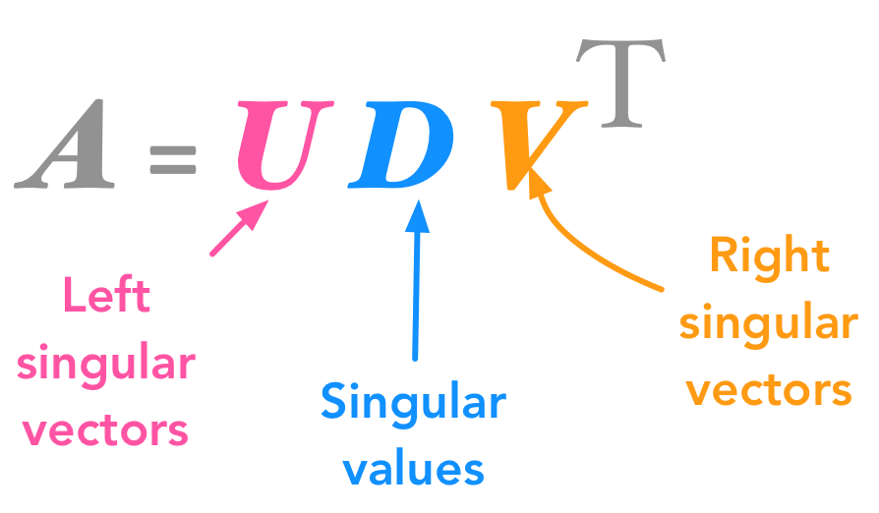
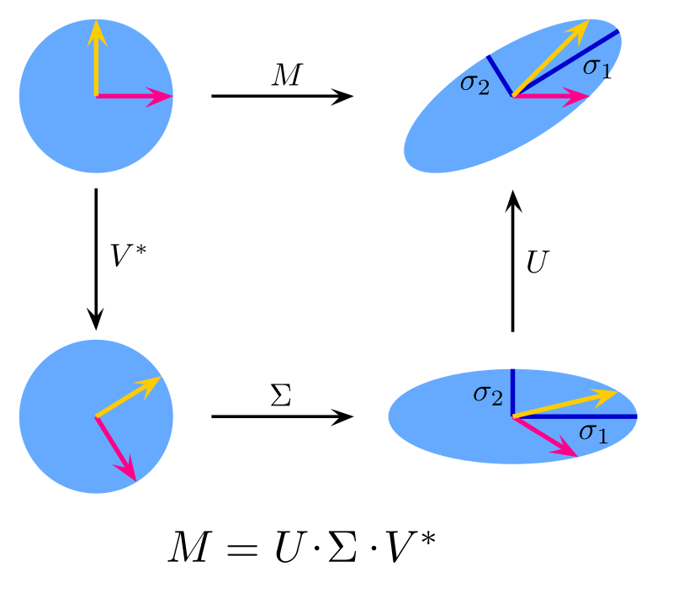
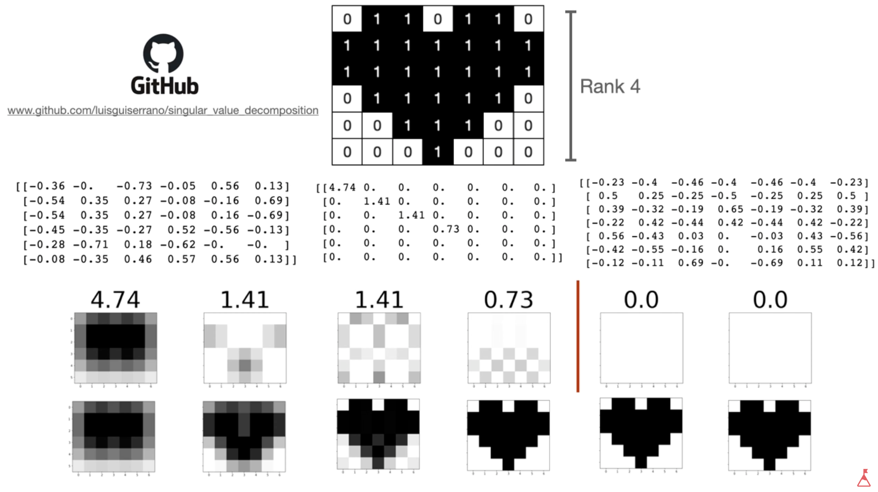
SVD
singular values (sss) from SVD are used to measure the importance of each component in capturing the variance of the data.
Notes:
https://www.youtube.com/watch?v=DG7YTlGnCEo
its all about rotation and stretching

Slide 17
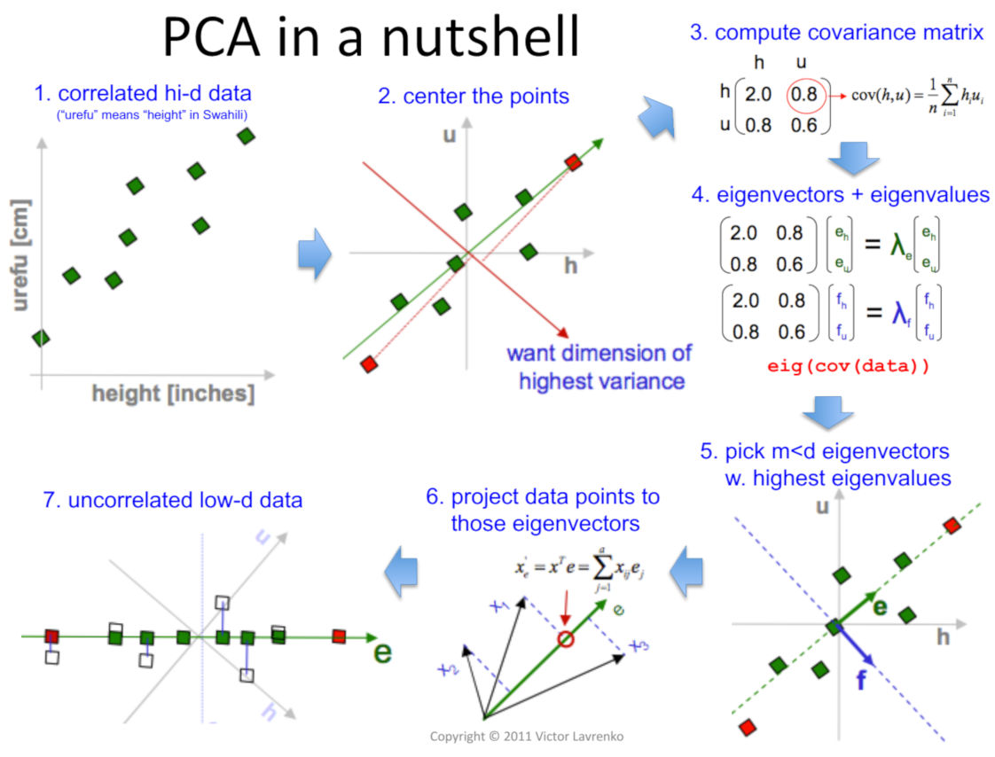
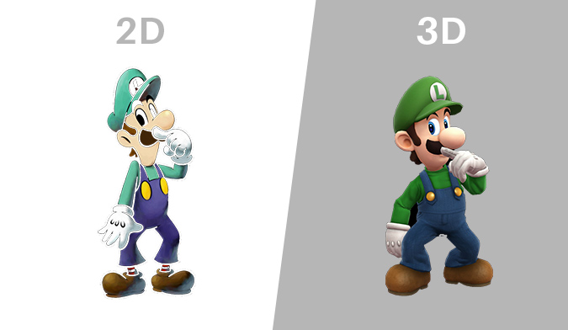
PCA
Use Cases for PCA
Dimensionality Reduction
Reducing the number of features for datasets with many variables while retaining variance.
Data Visualization
Projecting high-dimensional data into 2D or 3D for easier visualization.
Feature Extraction
Creating new, uncorrelated features (principal components) for machine learning.
Noise Filtering
Removing less significant components that represent noise in the data.
Image Compression
Reducing image dimensions while preserving essential details.
Anomaly Detection
Identifying unusual data points by comparing their projections on principal components.
Finance
Identifying key factors that drive asset returns (e.g., stock market analysis).
Genomics
Reducing dimensions in large-scale gene expression datasets for clustering or visualization.

Slide 18
Cluster Analysis

Slide 19
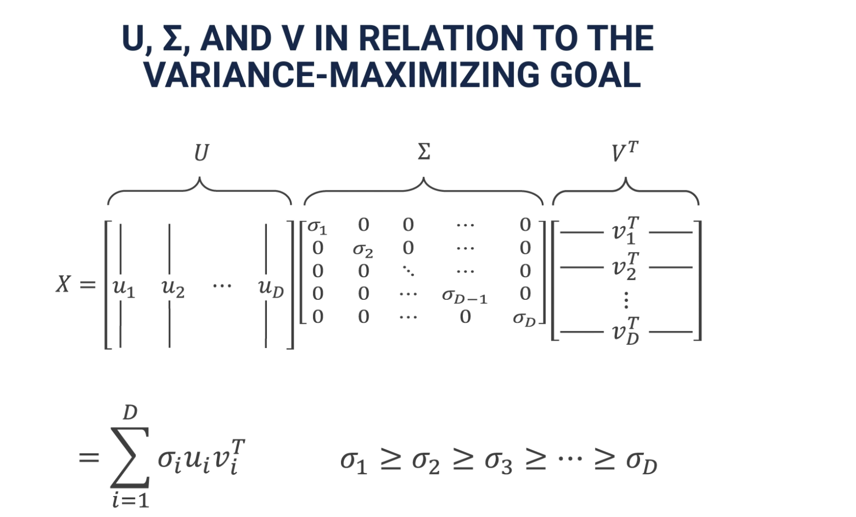
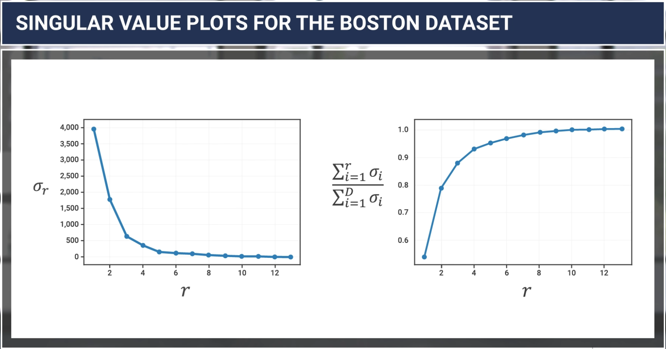
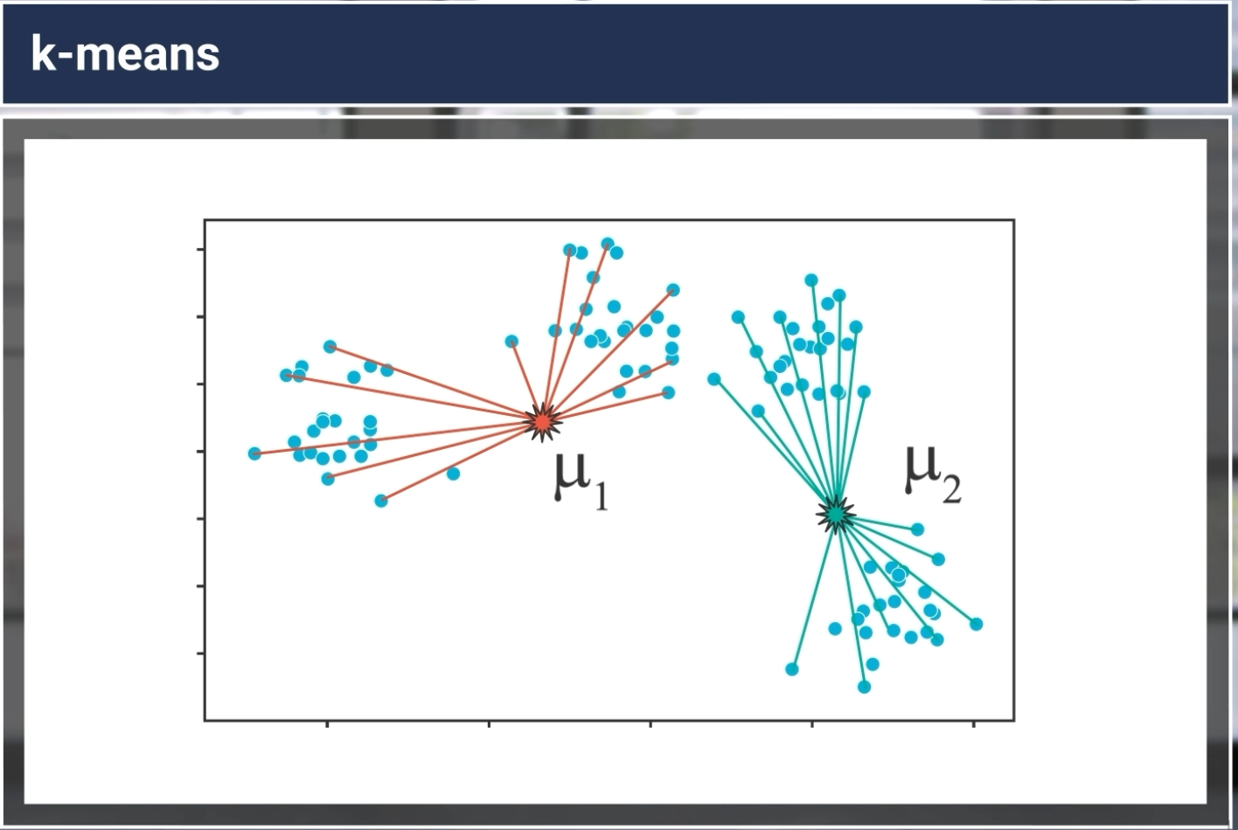
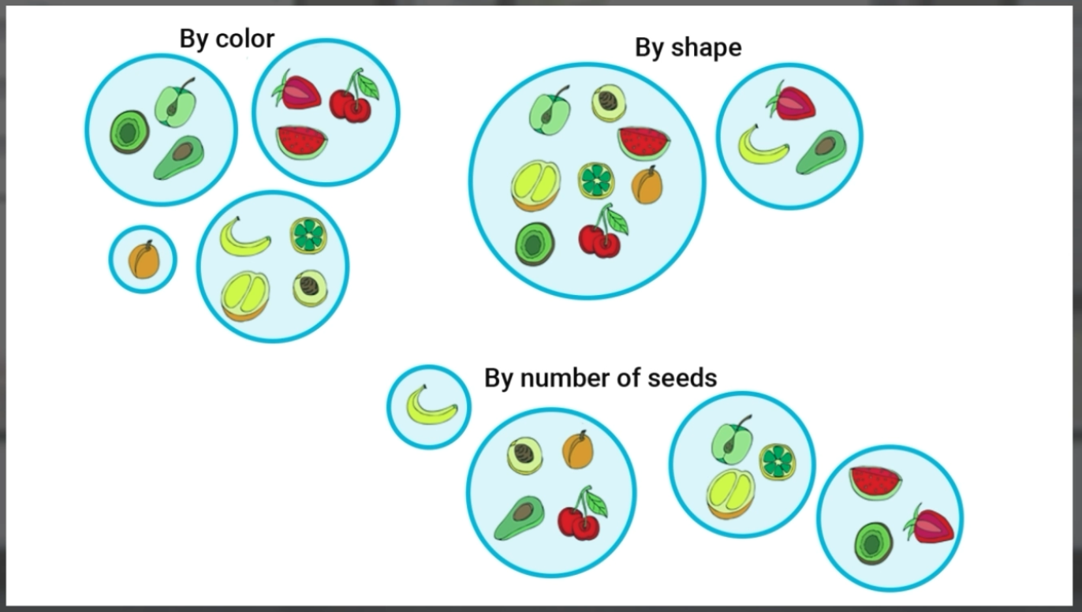
Appendix

Slide 20
Q&A

